Slide 1
Unit 203: Electrical installations technology
Electricity supply

Slide 2
Electricity supply
The electricity supply industry comprises:
generation
transmission
distribution.

Slide 3
Electricity supply
Three transmission voltages are used:
400kV
275kV
132kV.

Slide 4
Electricity supply
Three distribution voltages are used:
33kV
11kV
400/230V.

Slide 5
Electricity supply
Component parts of the electrical distribution network include:
sub-stations
pylons
power stations
cables
insulators
transformers.

Slide 6
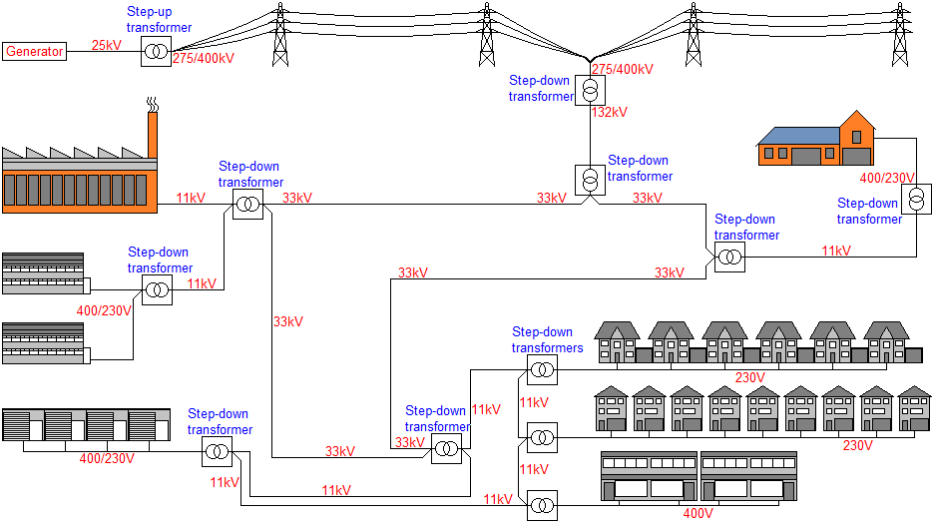
Electricity supply

Slide 7
Unit 203: Electrical installations technology
The End

